Slide 1



Khac Minh Dai Vo, Jerrik Johnson, Colton Goetjen, Travis Xu

Slide 2
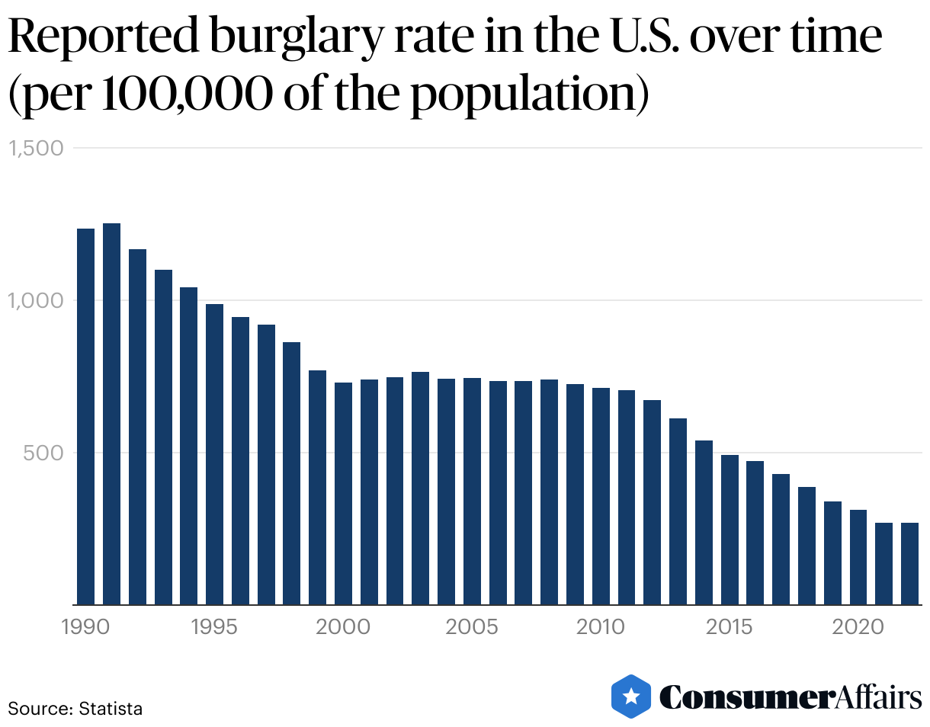
Background and Problems
Code Grabbing and Replay Attacks.​
Weak Default Codes and Passwords.​
Limited Monitoring and Alerting Capabilities.​
Lack additional layer of Security. ​
Ease of Use​
Notes:
Colton
With the sophistication of break-in methods and the increased dependence on automatic garage door openers, there is an need for more secure access control systems.
Advances in authentication technology, such as biometrics, voice recognition, and smartphone integration, have created new opportunities for stronger security measures.
people also want easy access to their garage. They want technologies that combine security and convenience of use.

Slide 3
Objective and Goals
Creating a system to keep the Garage secure was the main idea but with specific implementations.
Universally installed on all garage systems
Avoid the use of the fob
Ease of installation and use
Simplify high-end security system
We came up with Garage Go, a kit made to be installed by the homeowner and controlled with an app.
Notes:
Dai
So How many people in here have a garage at home? How many people open the garage using their phone? As most of us in here, we have to use the garage at least twice a day like going to school and back and garage is obviously our first layer of defence. So our goal objective is to create a product where it can help to enhance access control to the garage and also easy to use through the app. Therefore, we came up with a kit included a smart-press and smart-power toggle that are very simple to connect with only 4 steps and it is applicable to different type of garage system. Our team Mission Statement strongly focusing on safety, we want to deliver innovative solutions with highest customer satisfaction ensuring every person goes home from work or school, safe and sound.

Slide 4
Mission
"Enhancing Garage Safety through dual locking System."
​
“Our mission is to provide homeowners with peace of mind by offering a comprehensive garage security solution through our innovative kit. We are dedicated to delivering a dual locking system that ensures the garage security, convenience, and control, empowering our customers to safeguard their belongings with confidence.”
Notes:
Dai

Slide 5
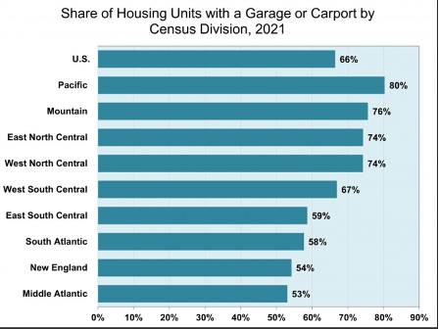
Primary Market
- The Garage Door Opener market is expected to grow significantly across multiple regions including:
Asia-Pacific
North America
South America
Europe
Middle East
South Africa
- The market is forecasted to achieve a compound annual growth rate (CAGR) of approximately 8.26% from 2022 to 2028.
- Revenue generated by the Garage Door Opener market was USD 1.21 billion in 2022.
- The market is projected to reach USD 1.95 billion by 2028.
Notes:
Travis
See image - The market is proven to have a great increase in growth which we could apply our product. You can here that the market is very large and wide spread with over 50% of the

Slide 6
Competitors
 | Easy-Install | Price | Secure
Chamberlain | ✔️ | ❌ | ✔️
Meross | ❌ | ✔️ | ❌
Aubric | ✔️ | ✔️ | ❌
Garage Go | ✔️ | ✔️ | ✔️

Slide 7
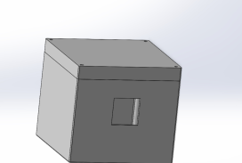
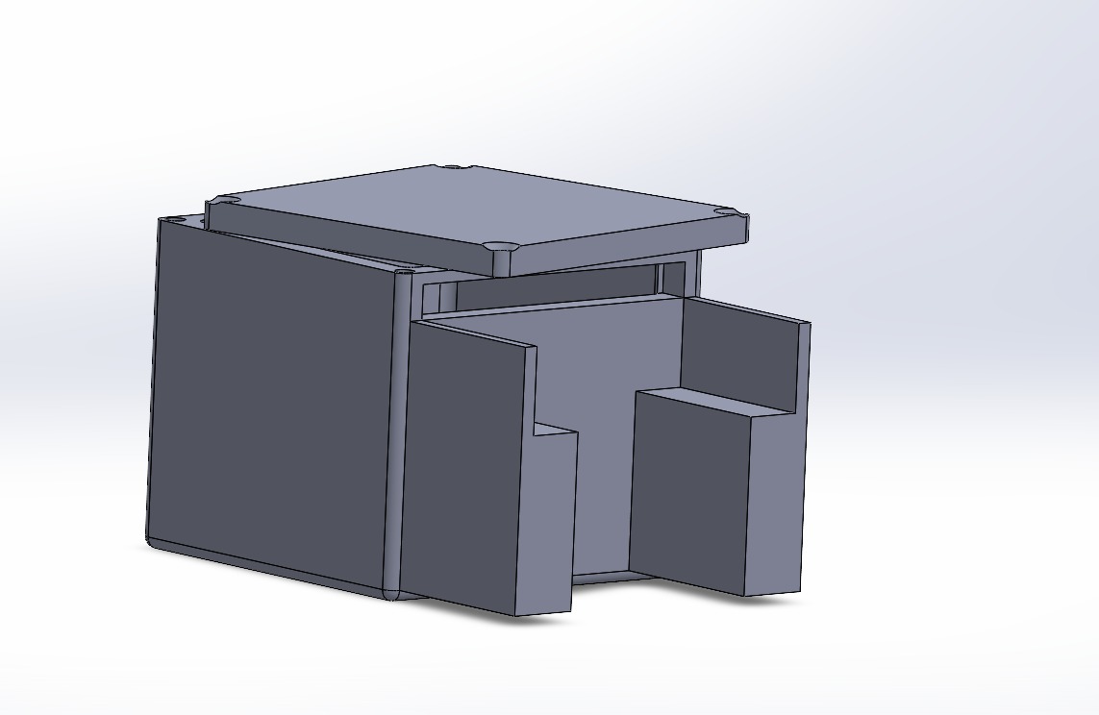
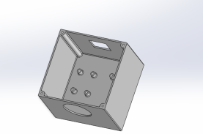
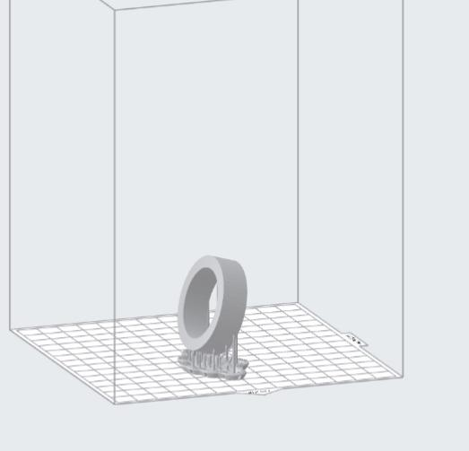
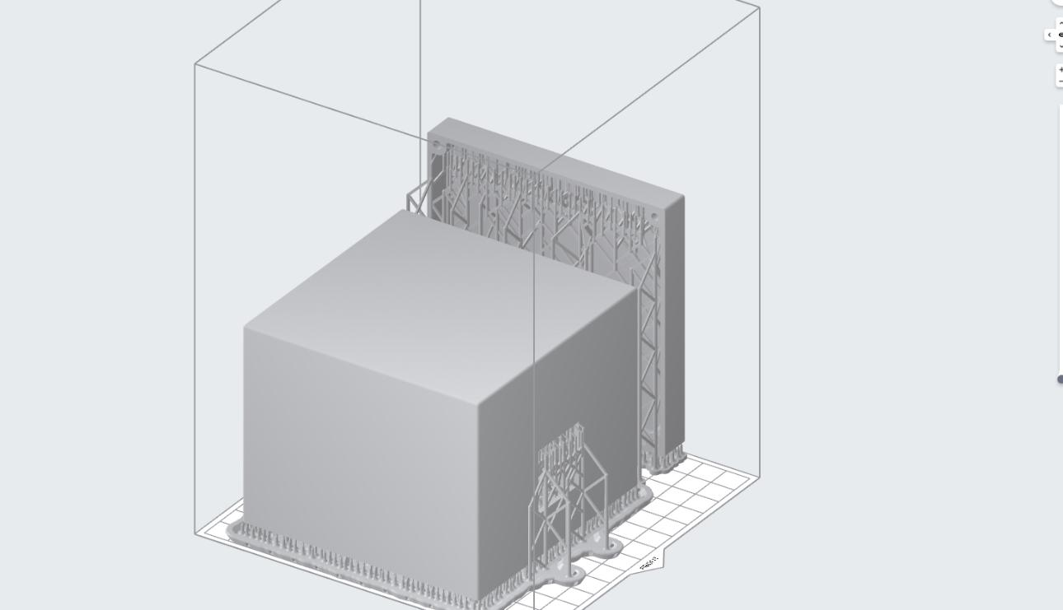
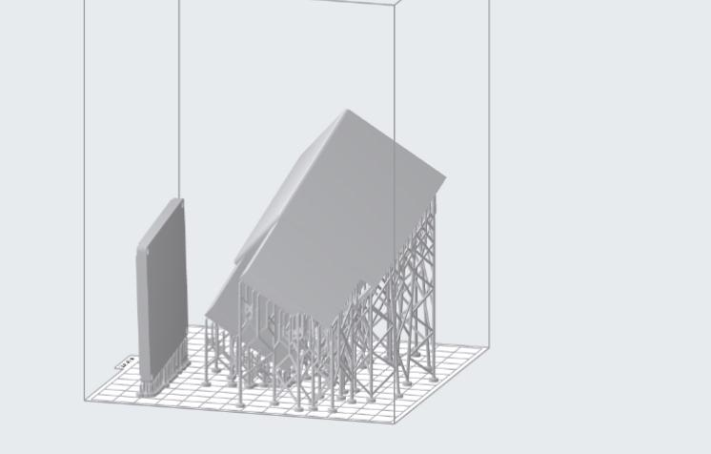
CAD Design
SolidWorks.
Formlabs.
23 Hour Total Print Time

Slide 8
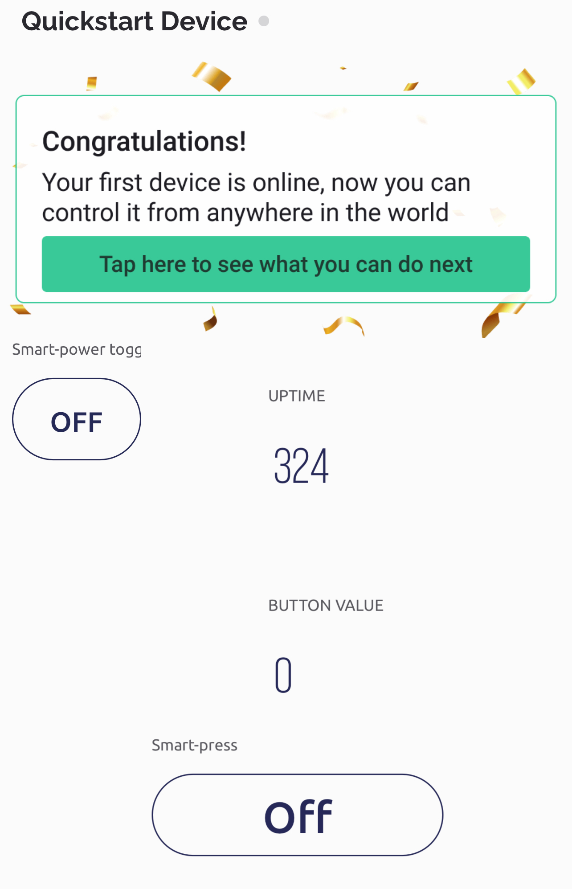
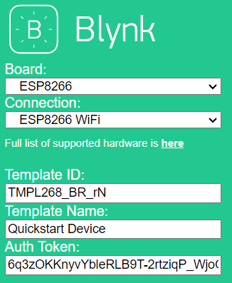
How can I connect it?
Download the Blynk app on your phone(Android & IOS).
An email with Blynk Token will be sent to your personal email address.
Apply the Token with our provided app to link with the microcontroller and control it from Blynk.
Use the Smart-Press for garage opener and Smart-Power Toggle for switching on/off garage motor.
Bonus: More smart IoT devices at your home can totally be added into here!

Slide 9
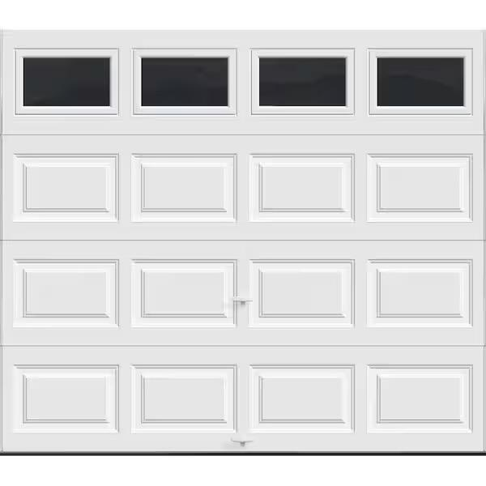
Demo
Garage Go Video Demo Link

Slide 10
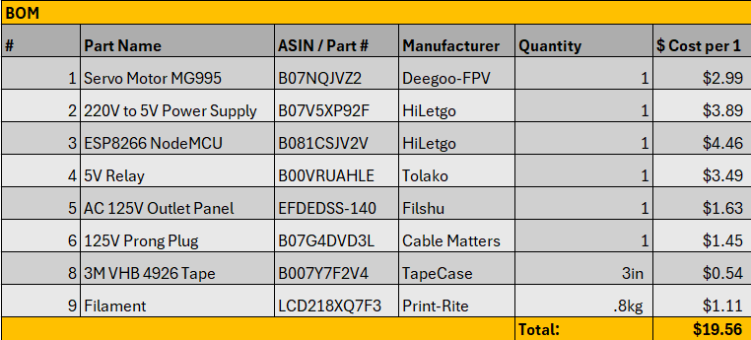
Cost Analysis
Based on 1000 units

Slide 11
Road Map
Open the product to other applications
Draft remote frequencies and void smart press
Independent Application
Sleek low profile/modern design
Notes:
Anticipated Problems
False Positives/Negatives
Wifi-based
Limited capability for online software updates.
Future improvements
Reduce the size and enhance the compactness of the product.
Find ways to make duo-authentication security more convenient
Independent Application for the Kit
Enhance the user-friendliness of the garage application.
Draft remote frequencies and void the push button
Consider integrating Alexa or another AI system

Slide 12
Thank you!
Learn more about Garage Go and how it can enhance the security of your garage. Contact us at contactus@garagego.com

Slide 13
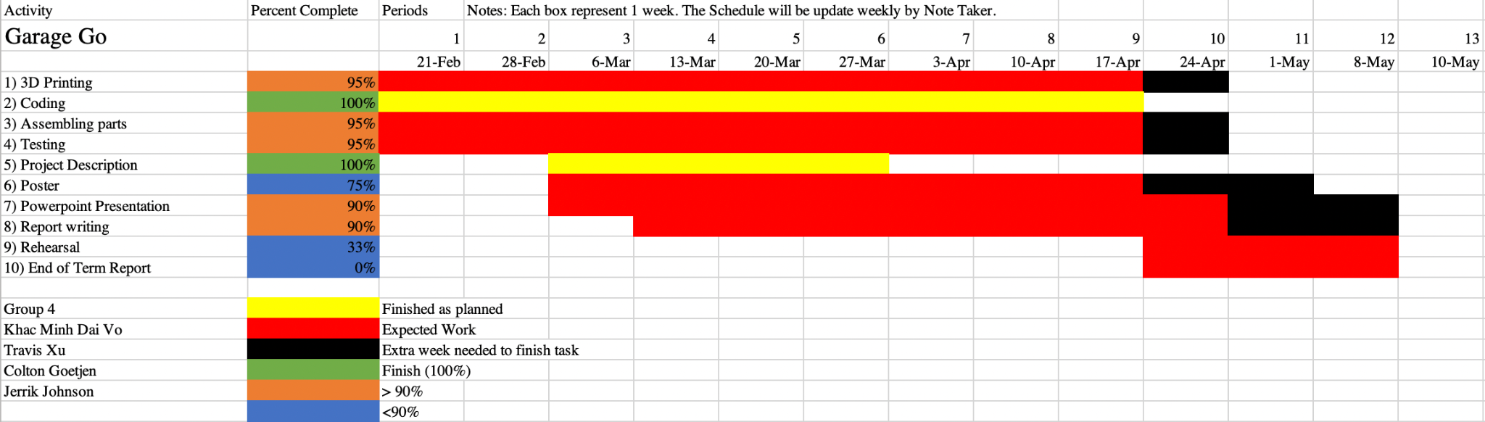
Review of project schedule

Slide 14
Work completed
General Task Management & Team Lead (Colton Goetljn)
Remind and host weekly meetings.
Ensure deadlines are met.
Communicate between members for report progress.
Manufacturing (Jerrik Johnson)
Buying parts & components.
3D printing parts.
Assembling components and communicate with Coding & Testing manufacturing’s expectation.
Coding & Testing (Khac Minh Dai Vo)
Write code for both products on C++ and testing the code.
Work and testing ESP8266 board with breadboard.
Note-taker for meetings and communicate with Manufacturing coding’s expectations.
Application (Khac Minh Dai Vo & Travis Xu)
Researching and testing different apps to merge two products into 1 app.
Testing Blynk.

Slide 15
Conclusion
Utilizing Garage Go enhances the security of your garage, ensuring only authorized access with a dual locking security system.
A single kit and the download of an application will have your home that much more secure.

